Slide 1

User Interface E-Gate Pass
Web Development
SFPO research

Slide 2
Progress UI
UI | Progress | UI | Progress | UI | Progress
Login | done | EHS Gate Pass Detail | done | Report | done
Dashboard | done | Approval Page | Done | Profile | done
Submission General Gate pass | done | Return Goods Page |  | Import | done
Submission Logistic Gate Pass | done | Security Verify Page | done
Submission EHS Gate Pass | done | Gate Pass Record | done
General Gate Pass Detail | done | Data Master | done
Logistic Gate Pass Detail | done | Scan QR Gate pass | done

Slide 3
Progress UI
revision request | Page | revision request | Page
Revision Weight Chemical
Return Partial & extend date General
Return Partial & extend date Logistic
Vendor Detail Page
Vendor Add & Edit Modal
Edit Waste Data
Report page
Open
Open
Open
Open
Open
Open
Open

Slide 4
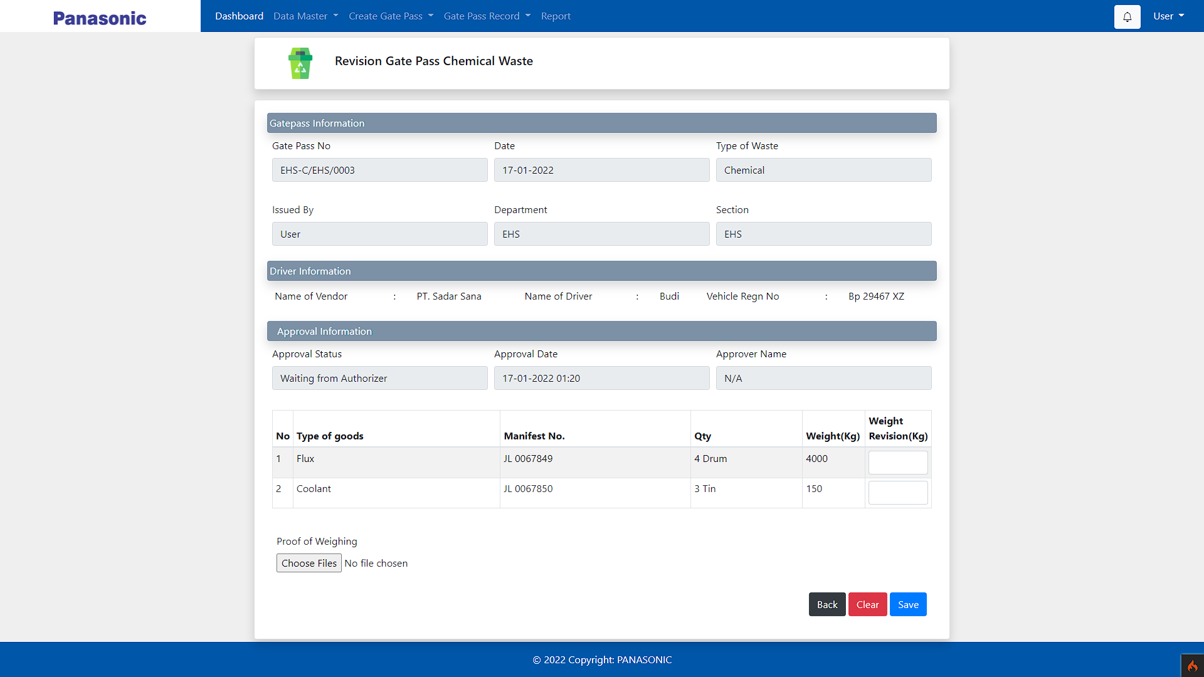
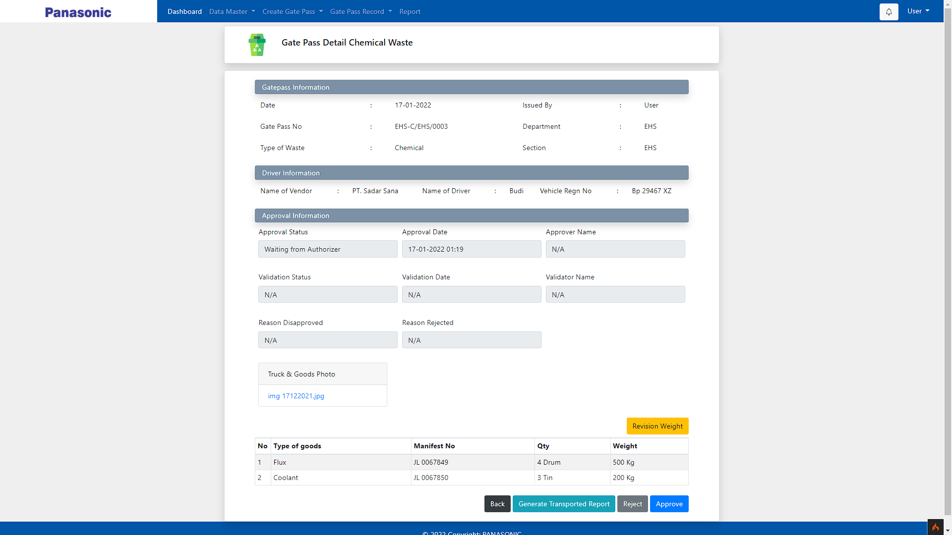
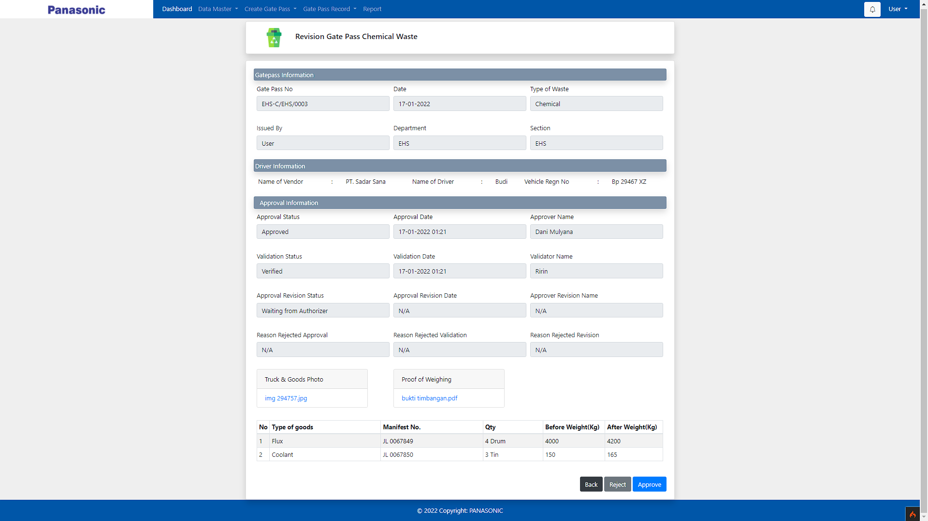
Revision Weight
Chemical

Slide 5
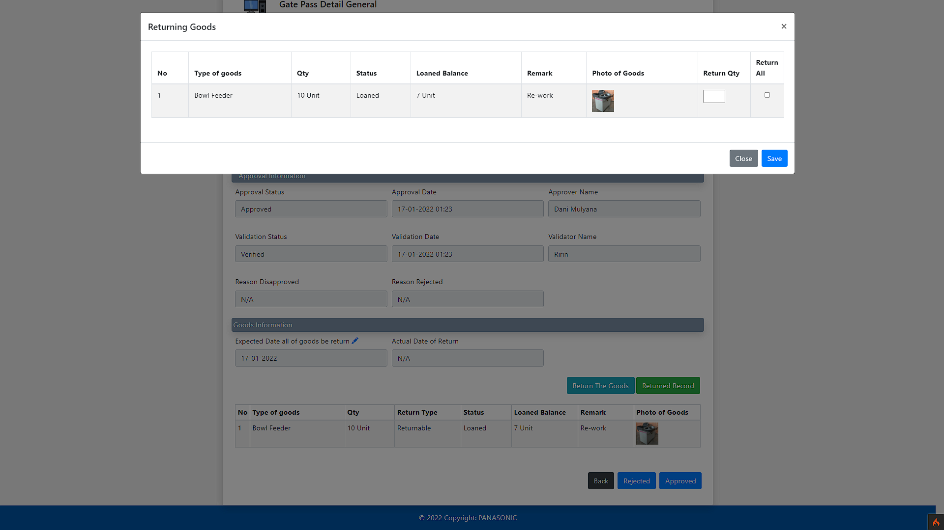
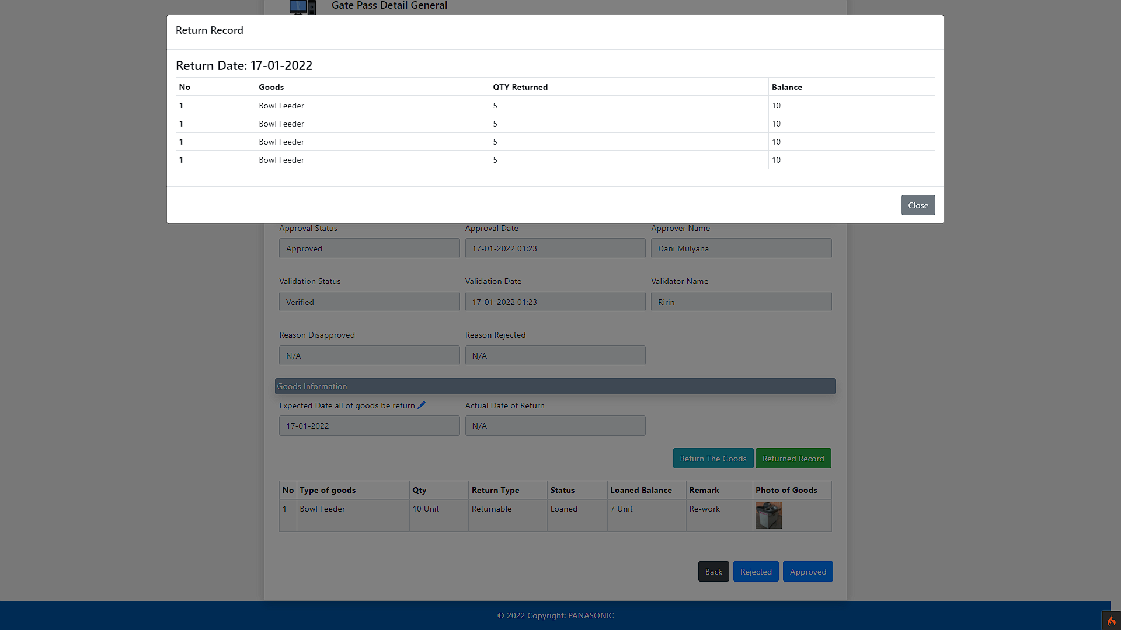
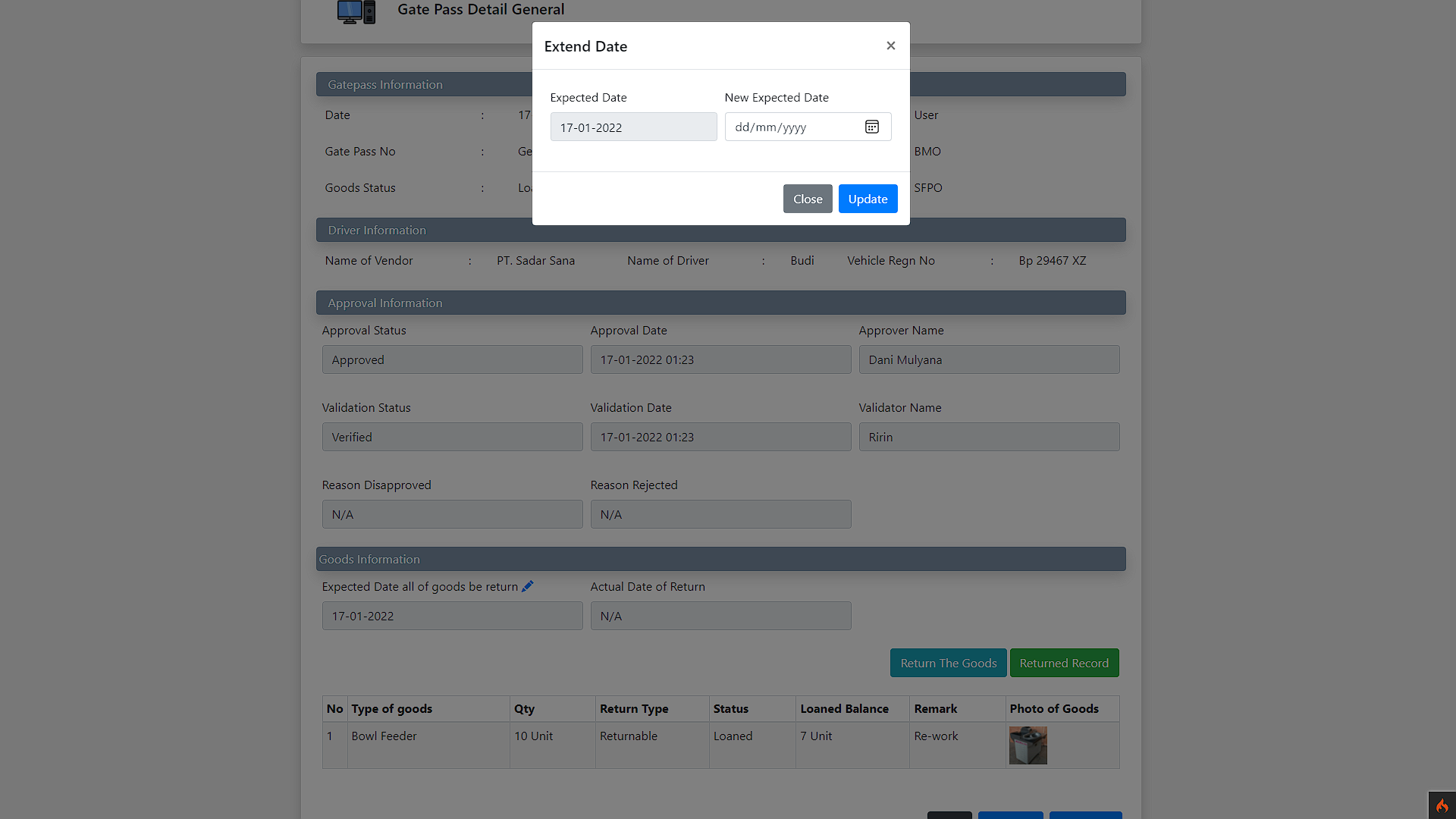
Return Partial
General

Slide 6
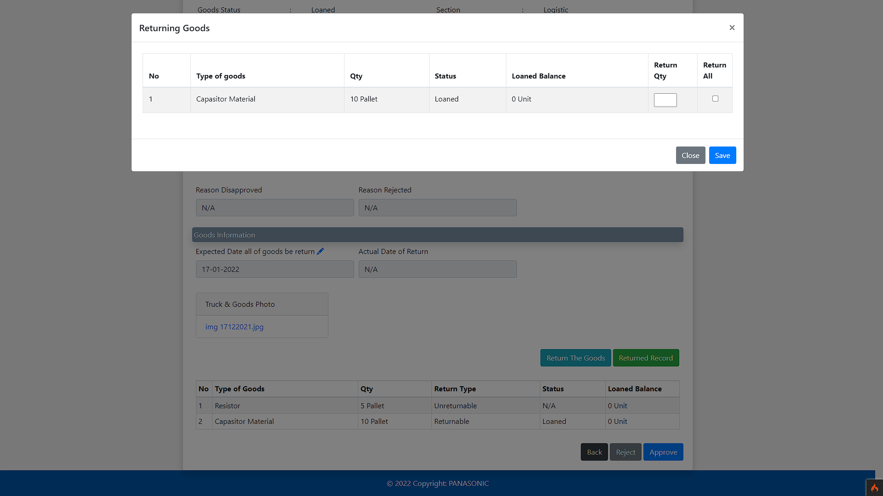
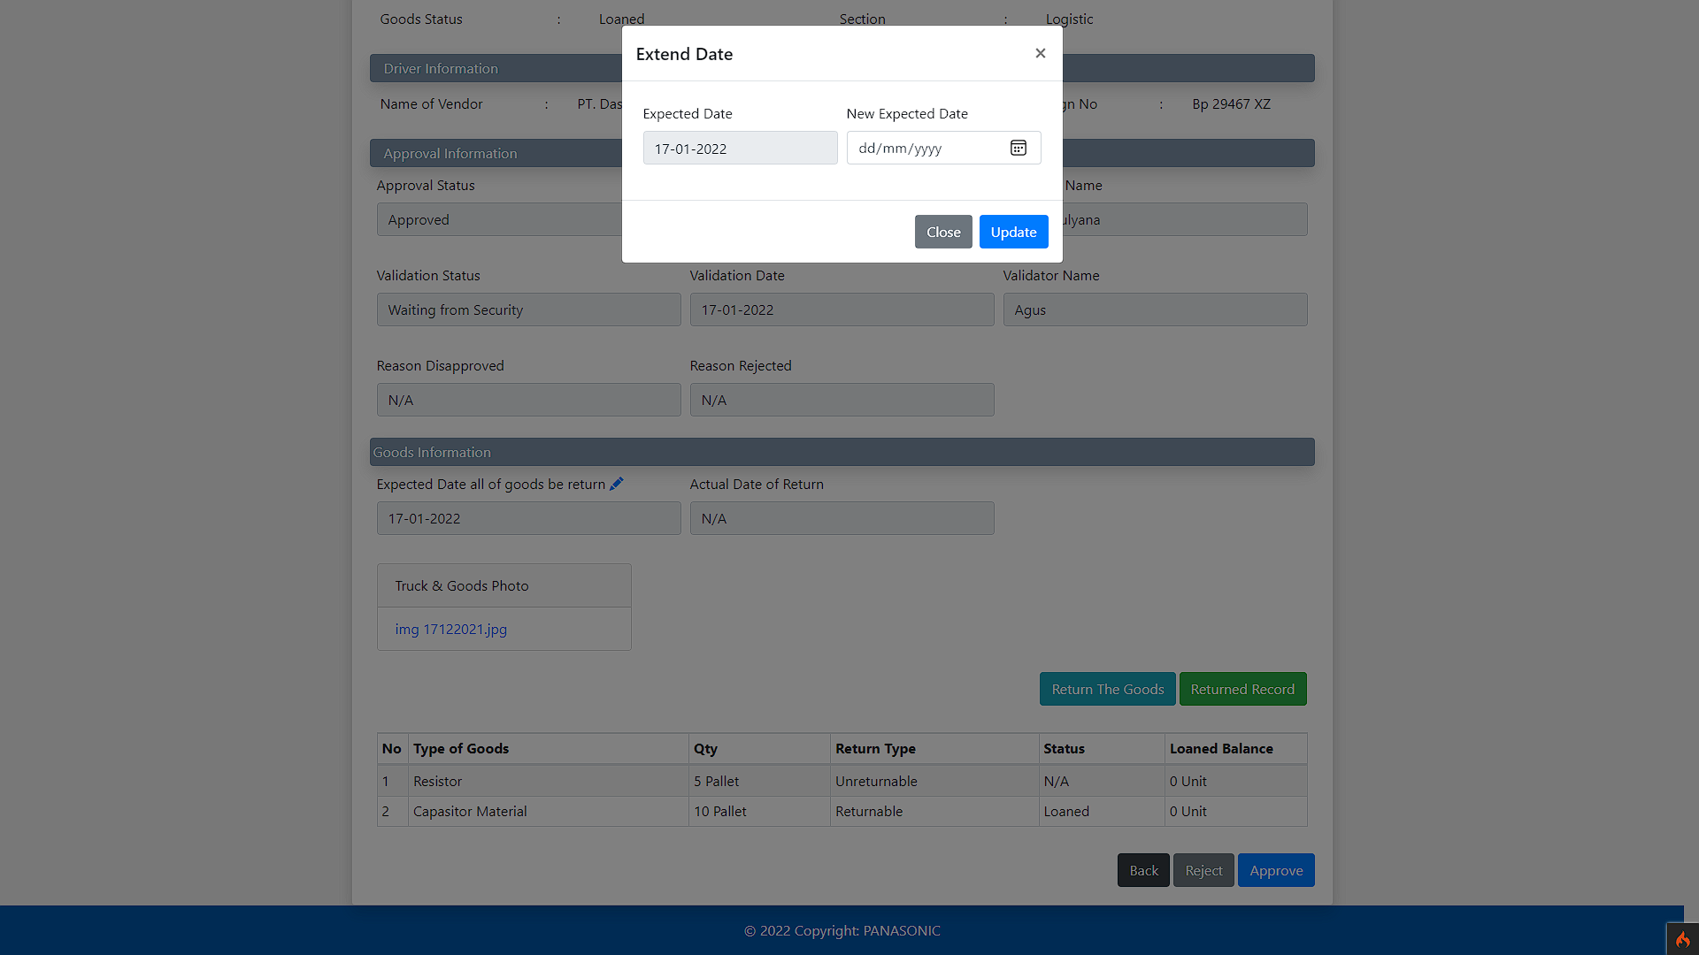
Return Partial
Logistic

Slide 7
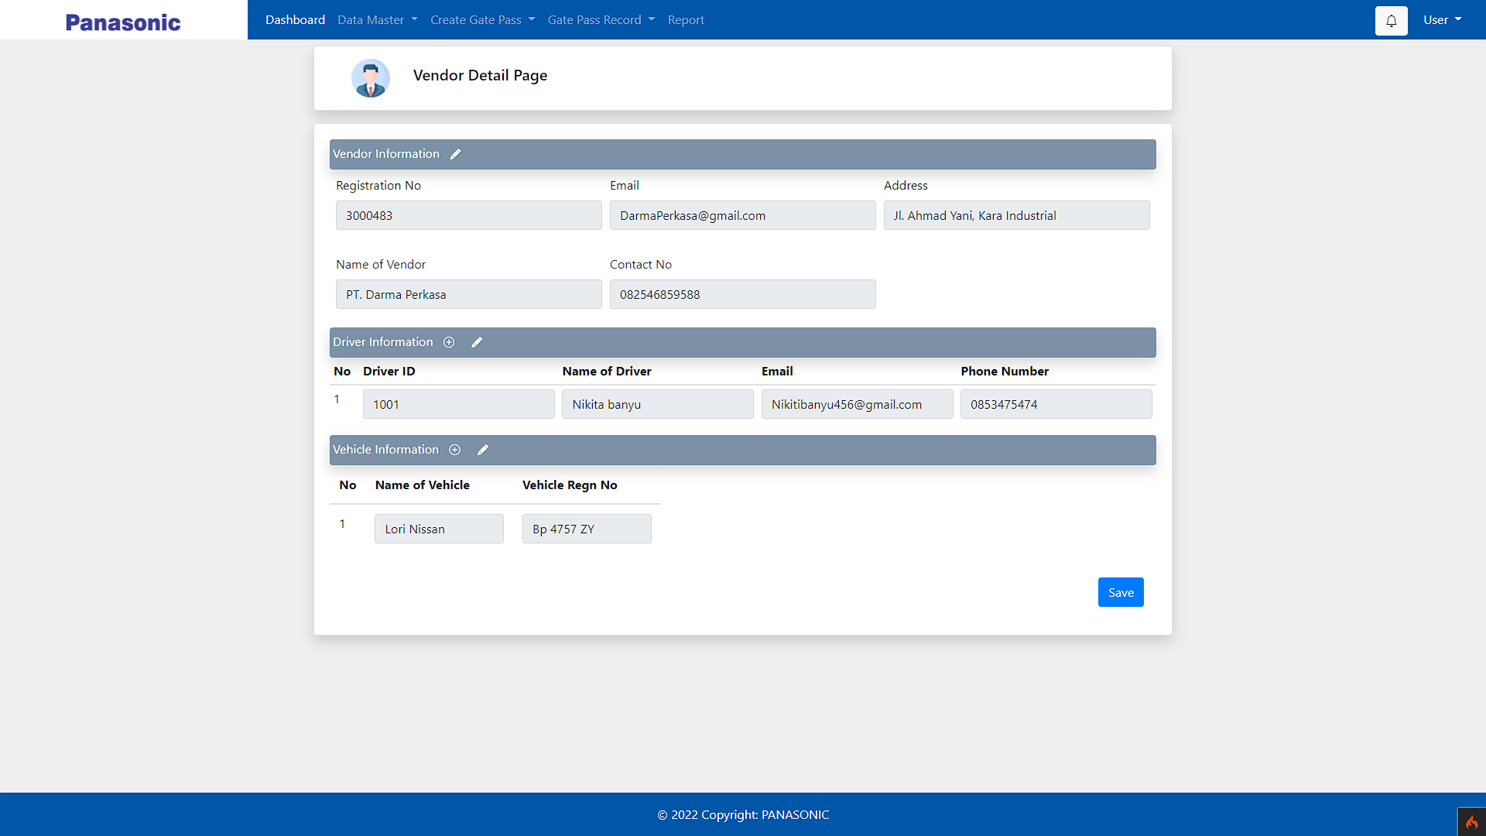
Vendor Detail
page

Slide 8
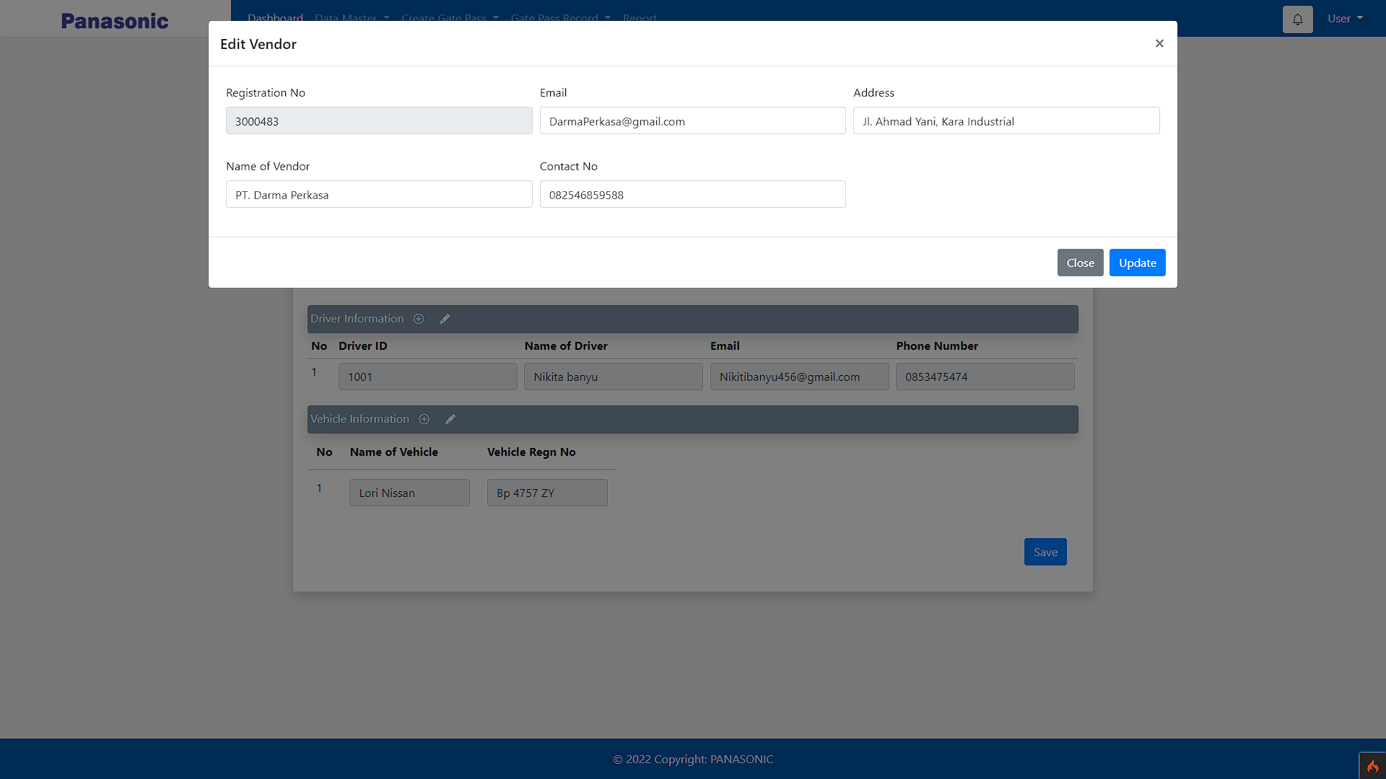
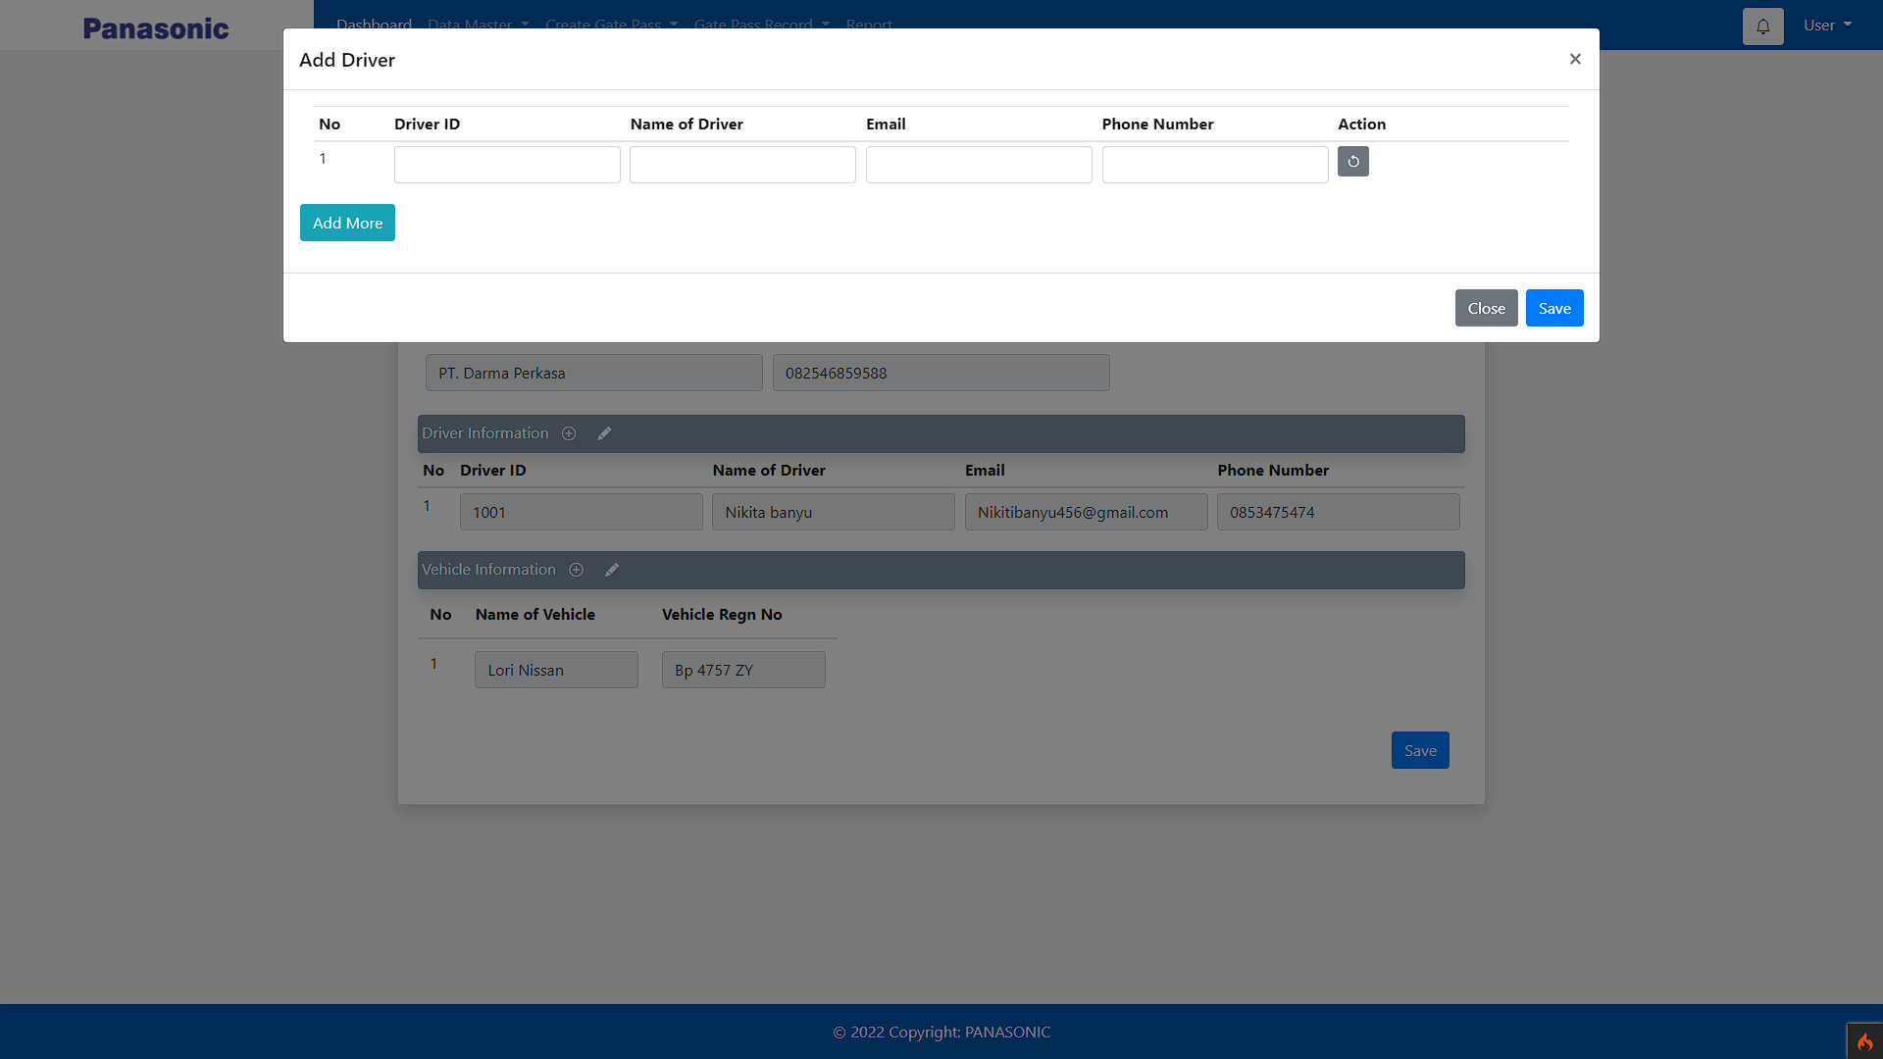
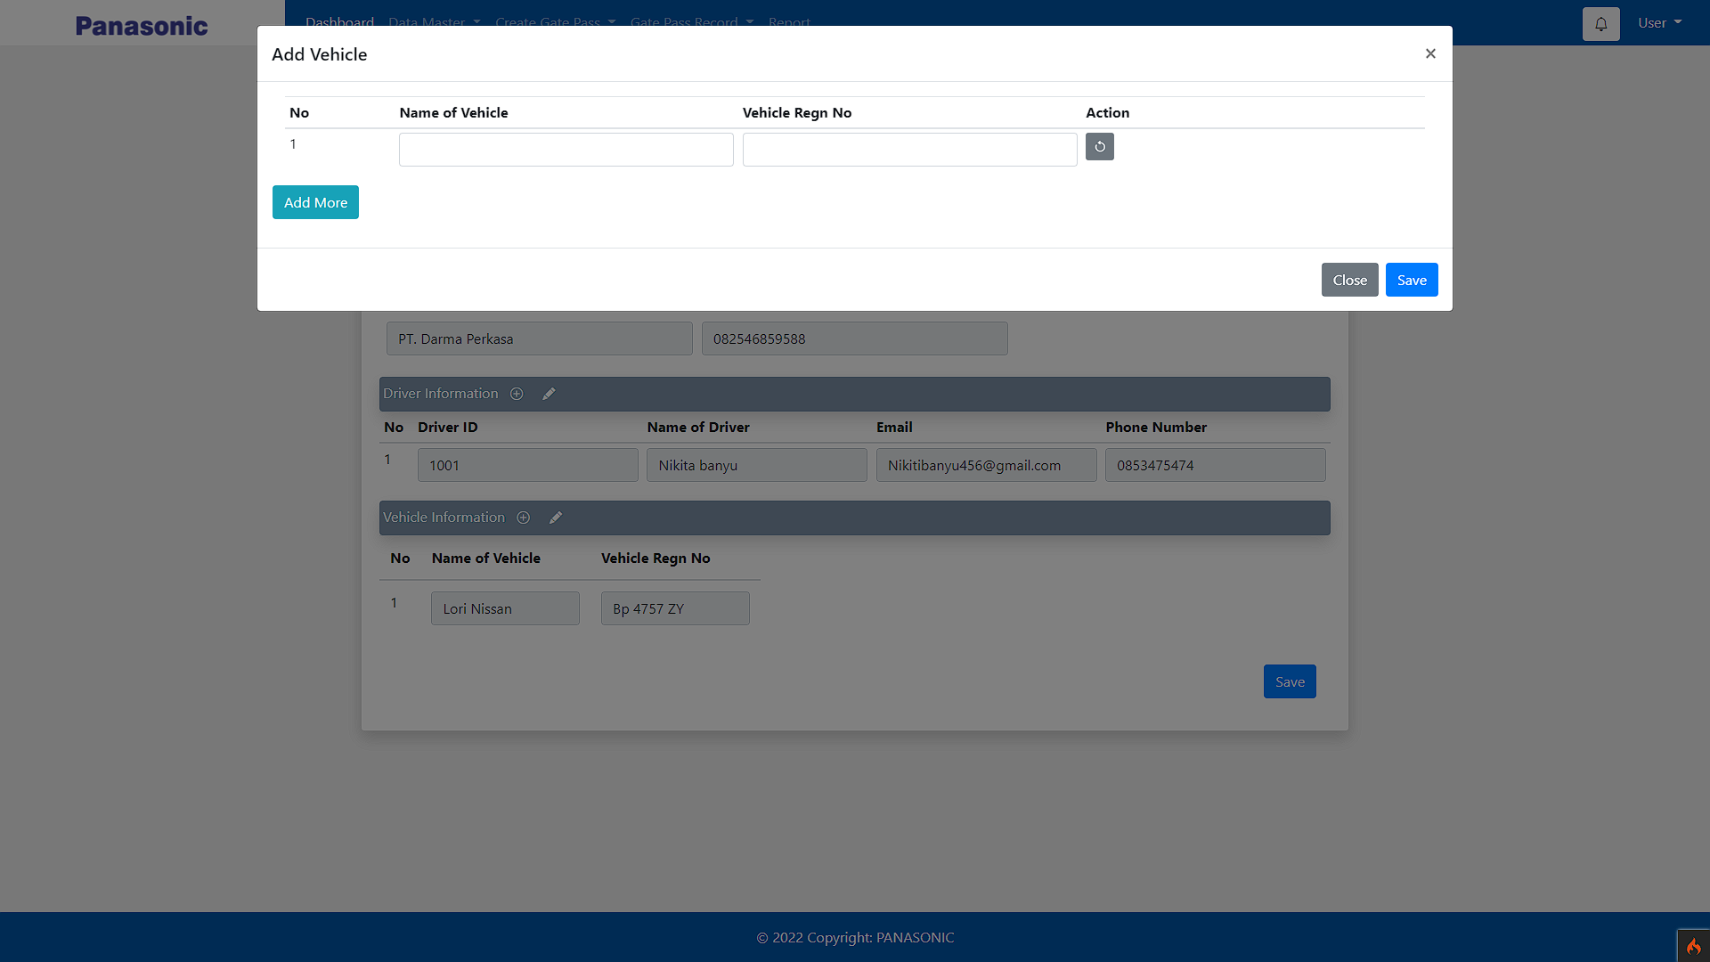
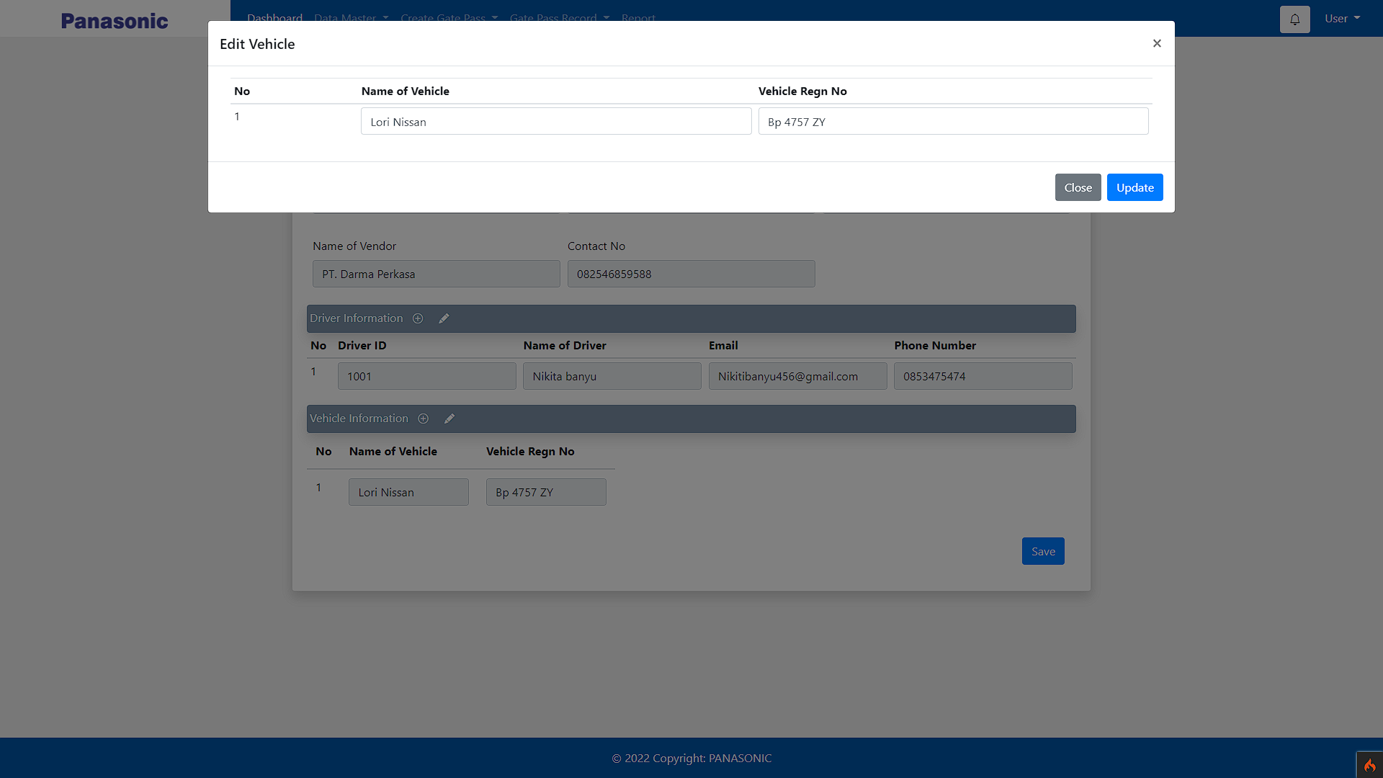
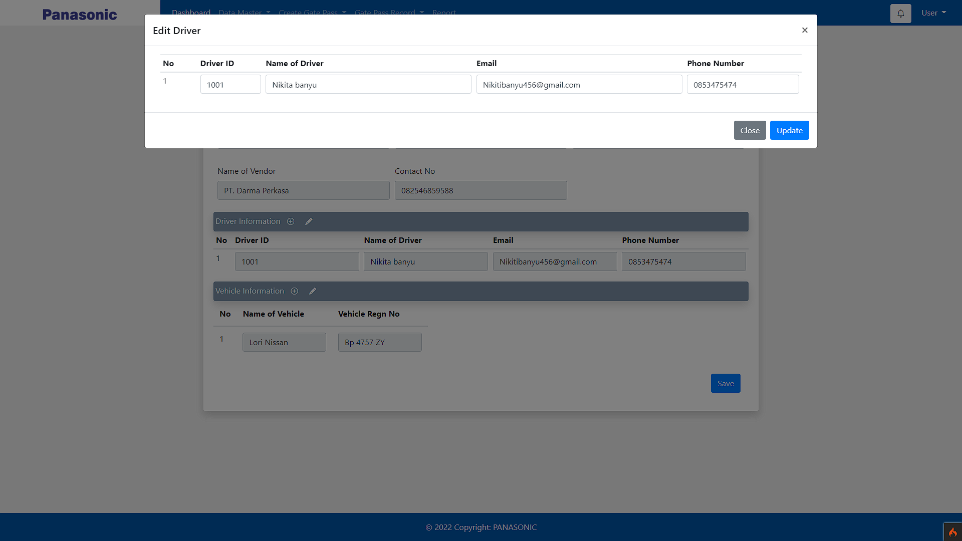

Vendor Add & Edit
Modal

Slide 9
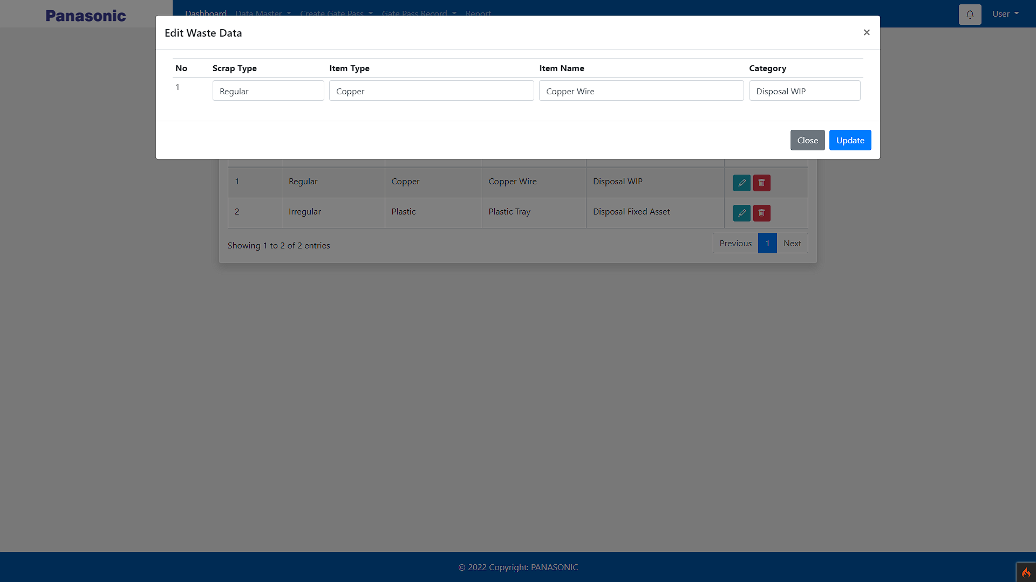
Waste Edit
Modal

Slide 10
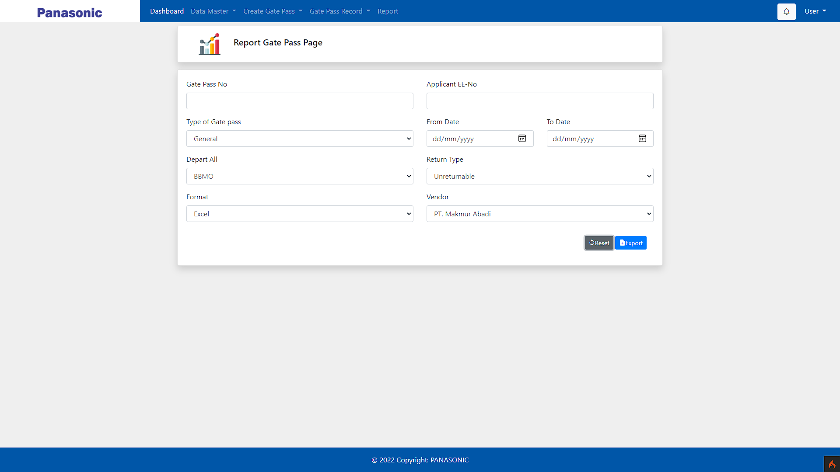
Report Page

